Slide 1
CHAPTER 6 SEQUENTIAL LOGIC

Slide 2
INTRODUCTION
Combinational Circuits: A circuit whose output, at any instant of time are dependent upon the input present at that time.
i.e. Half Adder, Full Adder
Sequential Circuits: A circuit whose output depends not only on the present inputs but also on the past history of inputs.
i.e. Flipflop

Slide 3
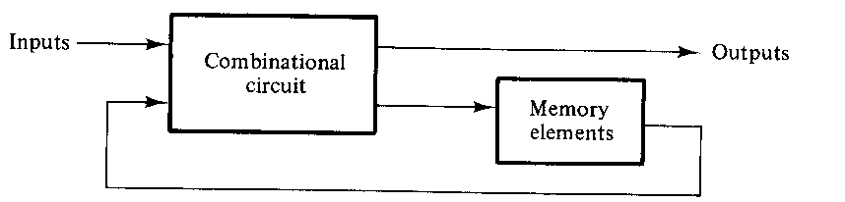
The memory element is devices capable of storing binary information within them.
The input is provided by external input.
These inputs, together with the present state of the memory elements, determine the binary value at the Output terminal as well as the condition for changing the state in the memory elements.

Slide 4
Types of Sequential Circuits:
Asynchronous Sequential Circuit: is a system whose behavior depends upon the order in which its input signals change and can be affected at any instant of time.
Synchronous Sequential Circuit: is a system whose behavior can be defined from the knowledge of its signals at discrete instant of time.
Clocked Sequential Circuit: Synchronous Sequential Circuits that use clock pulses in the inputs of memory elements are called Clocked Sequential Circuit.

Slide 5
FlipFlops:
The memory elements used in sequential circuits are called as FlipFlops.
These circuits are binary cells capable of storing one bit of information.
A FlipFlop has two outputs, one for the normal value and one for the complement value of the bit stored in it.

Slide 6
FlipFlop circuit can be constructed from two NAND gates or two NOR gates.
The cross-coupled connection from the output of one gate to the input of the other gate constitutes a feedback path.
Each FlipFlop has two outputs, Q and Q’, and two inputs SET and RESET.
This type of FlipFlop is called DIRECT COUPLED RS FLIPFLOPS or SR LATCH.

Slide 7
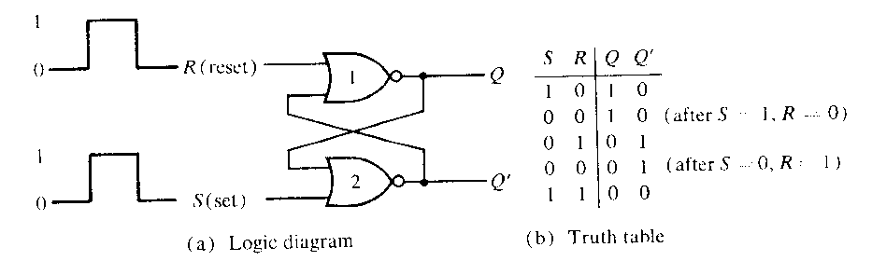
CLK | S | R | Q | Q’
0 | X | X | 1 | 0
1 | 0 | 0 | 1 | 0
1 | 0 | 1 | 0 | 1
1 | 1 | 0 | 1 | 0
1 | 1 | 1 | X | X

Slide 8
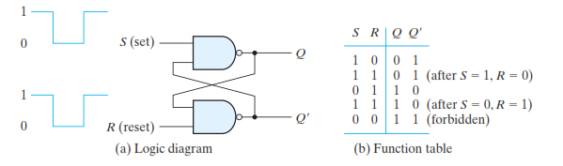
CLK | S | R | Q | Q’
0 | X | X | 1 | 0
1 | 0 | 0 | X | X
1 | 0 | 1 | 1 | 0
1 | 1 | 0 | 0 | 1
1 | 1 | 1 | 0 | 1

Slide 9
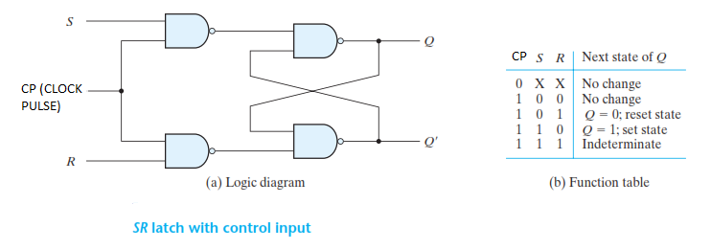
CLK | S | R | Q | Q’
0 | X | X | 1 | 0
1 | 0 | 0
1 | 0 | 1
1 | 1 | 0
1 | 1 | 1

Slide 10
Graphical Symbol
Q’ Q
R S
CLK

Slide 11
Characteristic Table
Characteristic Equation
Q(t) | S | R | Q(t+1)
0 | 0 | 0
0 | 0 | 1
0 | 1 | 0
0 | 1 | 1
1 | 0 | 0
1 | 0 | 1
1 | 1 | 0
1 | 1 | 1

Slide 12
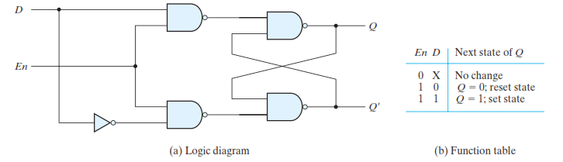
D FLIP-FLOP

Slide 13
Characteristic Table
Q(t) | D | Q(t+1)
0 | 0
0 | 1
1 | 0
1 | 1

Slide 14
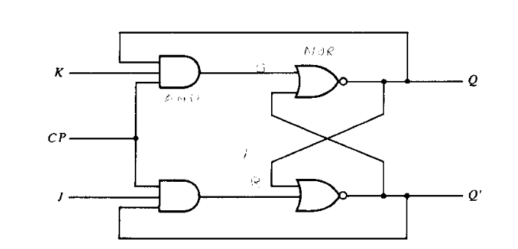
JK FLIP-FLOP
CP | J | K | Q | Q’
0 | X | X | 0 | 1
1 | 0 | 0 | 0 | 1
1 | 0 | 1 | 0 | 1
1 | 1 | 0 | 1 | 0
1 | 1 | 1 | 0 | 1

Slide 15
Characteristic Table
Q(t) | J | K | Q(t+1)
0 | 0 | 0
0 | 0 | 1
0 | 1 | 0
0 | 1 | 1
1 | 0 | 0
1 | 0 | 1
1 | 1 | 0
1 | 1 | 1

Slide 16
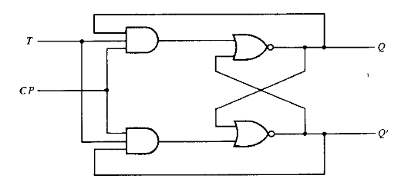
T FLIP FLOP
Characteristic Table
Q(t) | T | Q(t+1)
0 | 0 | 0
0 | 1 | 1
1 | 0 | 1
1 | 1 | 0

